Slide 1
Research Computing Update
February 2020

Slide 2
HPC Resources
MI HPC Cluster
In final stages of testing before moving critical HPC servers to news hardware.
The continued delay is partially attributed to PO for the HPC management software support still being in process
PO to renew support for h/w was cancelled at end of 2019. Will need to reinitiate
SAN HPC
Unable to renew onsite engineer contract
New HPC Procurement via ANKABUT
Still in process.

Slide 3
Training
“Introduction to Linux” course developed and delivered
Successfully delivered course, which includes students, faculty and researchers.
Course was well received and well attended.
Course is a prerequisite to existing “Intro to HPC”
“Introduction to HPC” course delivered
Developed an short, approximately 1 hour course to HPC with intention of making it a prerequisite to getting an account on HPC. This will be piloted shortly

Slide 4
Resource Utilization

Slide 5
MI Cluster core distribution

Slide 6
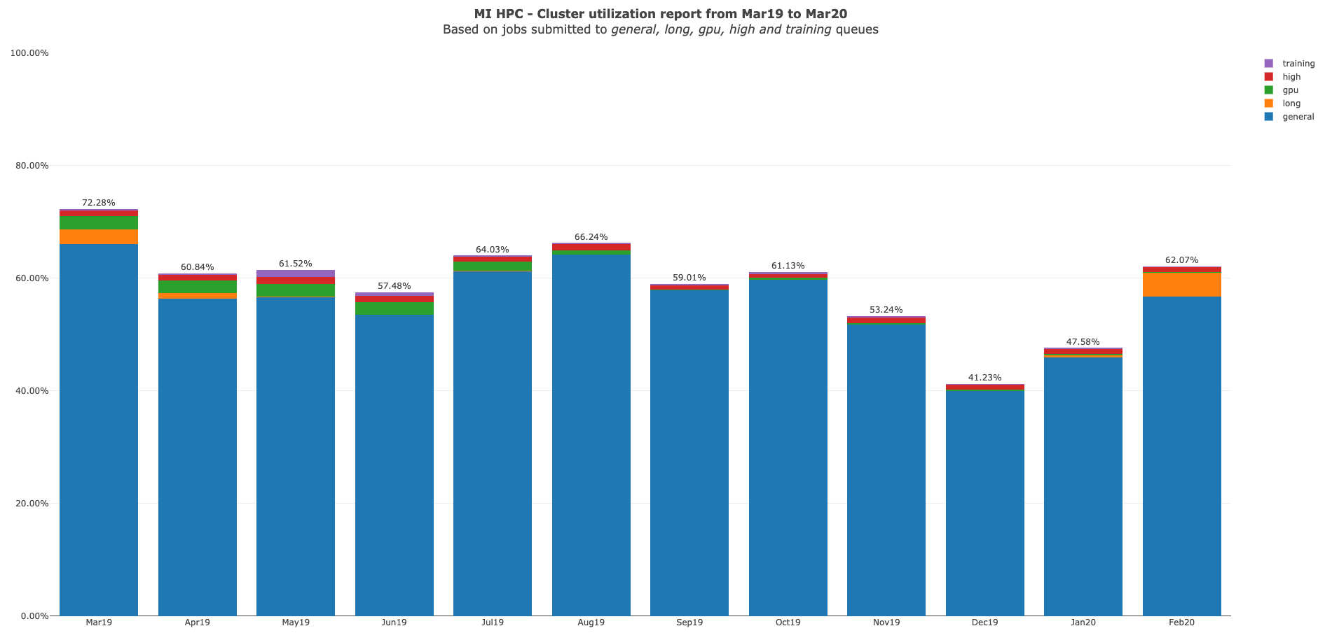

Slide 7
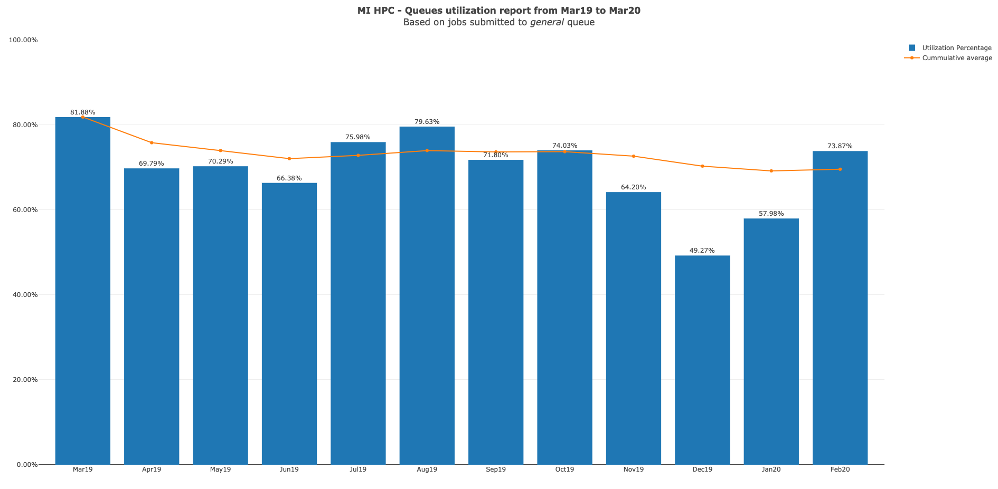

Slide 8
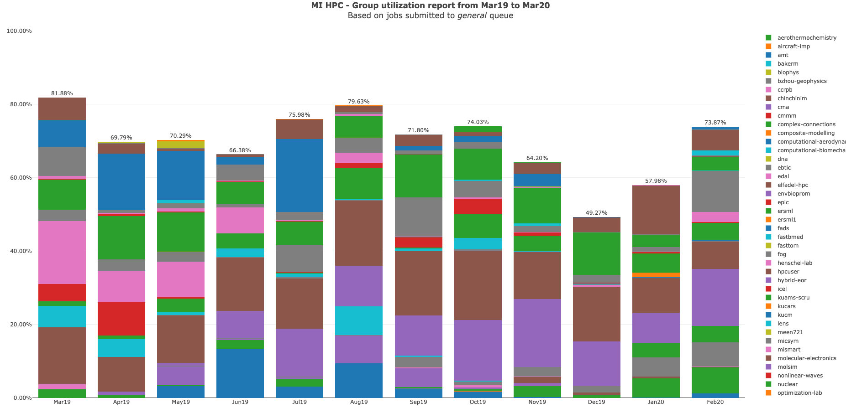

Slide 9
MI HPC Group Utilization for February 2020

Slide 10
PI Cluster core distribution

Slide 11
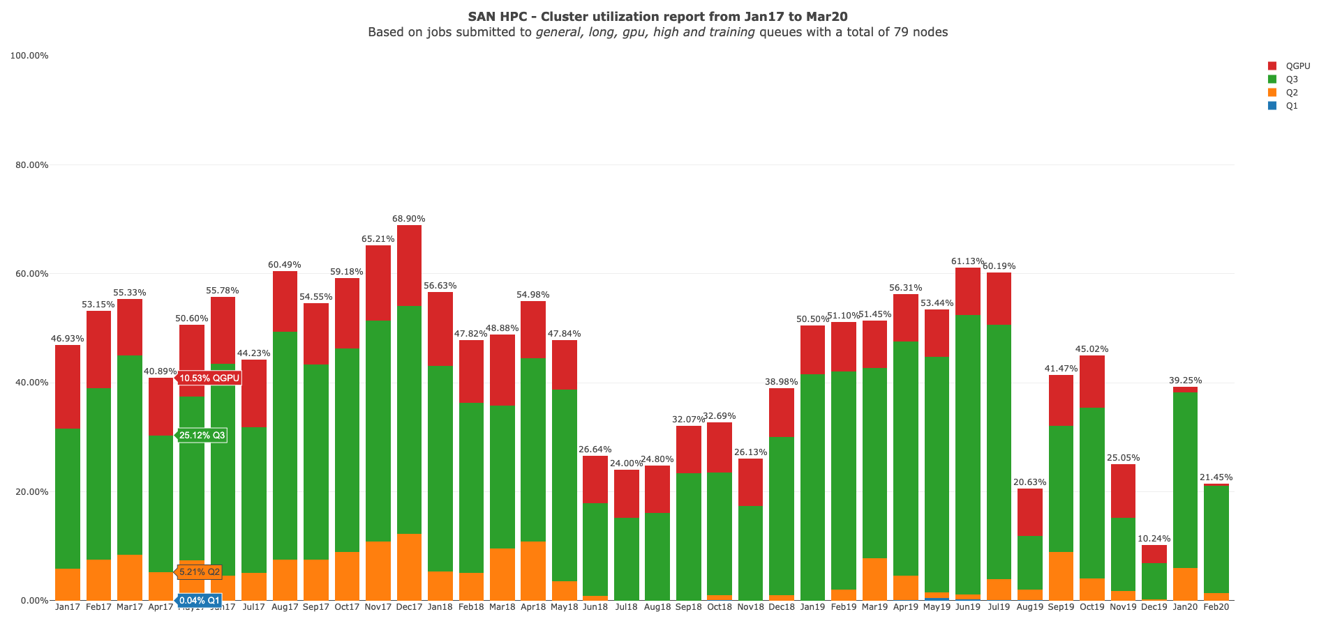

Slide 12
Status of KPI’s

